Slide 1

www.mathcounts.org

Slide 2


Slide 3


Slide 4

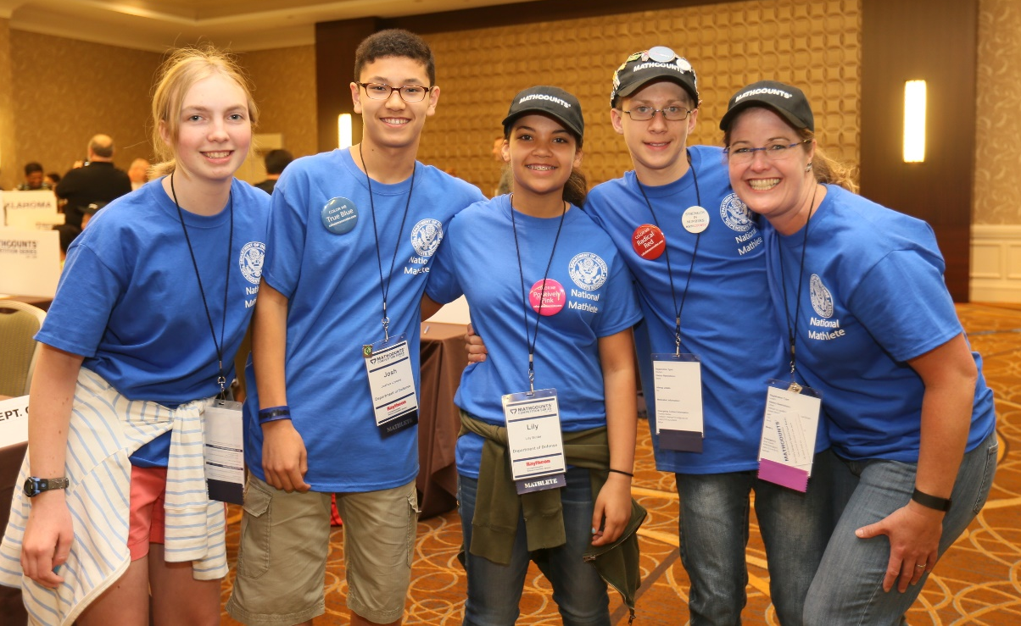
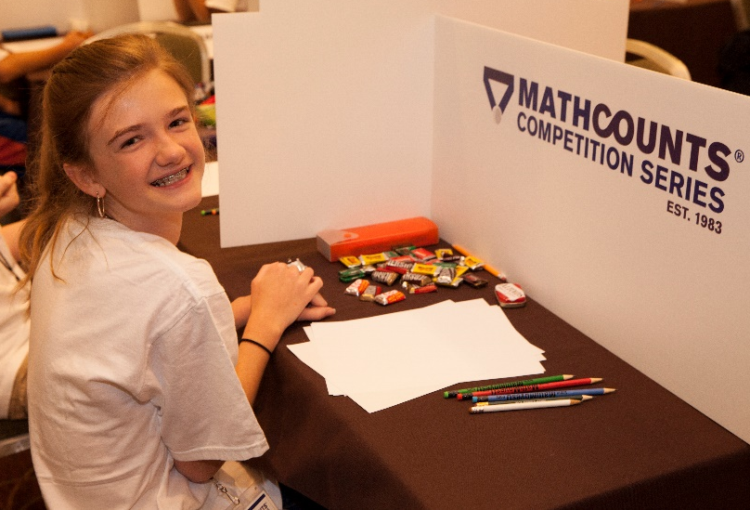
The MATHCOUNTS Competition Series is the premiere math competition for middle school students in the United States.
With live events in over 500 locations
every year, MATHCOUNTS is the
only nationwide competition that brings
students together to compete
in-person in math.

Slide 5
1 National Champion is crowned during the Countdown Round of the National Competition, webcast on ESPN
224 top students earn an all-expenses-paid trip to the National Competition in May
State Competitions are held in 56 states
and U.S. territories in March
35,000 students advance to one of 500
inter-school Chapter Competitions in February
65,000 students in 4,000 schools take part in intra-school competitions

Slide 6
Individual Written Rounds
Sprint & Target
The Sprint Round focuses on speed and accuracy. Students have 40 minutes to complete 30 math problems without a calculator.
The Target Round focuses on problem-solving and mathematical reasoning. Students receive 4 pairs of problems and have 6 minutes to complete each pair, assuming the use of a calculator.

Slide 7
Written Team Round
The Team Round focuses on problem-solving and collaboration. Students have 20 minutes to complete 10 math problems, assuming the use of a calculator.
Only the 4 students on a school's team can take this round officially.

Slide 8
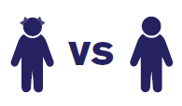
The Countdown Round
In the Countdown Round (CDR), the focus is on speed and accuracy. The highest scoring competitors from the individual written rounds compete against each other in one-on-one match-ups to determine the winner.
No calculators are allowed in this round.

Slide 9
If 3x + 155 = 272, then what is the value of 3x + 160?
3x + 155 = 272
3x + 155 − 155 = 272 − 155
3x ÷ 3 = 117 ÷ 3
x = 39
3x + 155 + 5 = 272 + 5
3x + 160 = 277
3(39) + 160 = 117 + 160 = 277
Notes:
This problem is a great way to teach students to really read the problem and consider what it is asking. There is a shortcut here that actually requires less math! A lot of times we are taught one approach to problems, but MATHCOUNTS loves to encourage students to always look for alternative and potentially quicker solutions.
Most students would immediately solve for x – which is often exactly what they are taught to do – but here they don’t have to solve for x!

Slide 10
Lily is going to the movies with Abby, Bea and Jaclyn. Abby wants to sit at the end of the row, and Bea only cares that she is seated next to Jaclyn. In how many different ways can the girls be seated in a single row that only has 4 seats?
Make a list:
ABJL LJBA
AJBL LBJA
ALBJ JBLA
ALJB BJLA
Therefore, 8 ways
Abby has 2 options:
A _ _ _ or _ _ _ A
Then Lily has 2 options:
A L _ _ or A _ _ L
Then Bea and Jaclyn have 2 options:
A L B J or A L J B
2 × 2 × 2 = 8 ways
OR

Slide 11
What is the maximum number of non-overlapping regions that can be determined by three lines in a plane?
Notice a pattern?
Lines Regions
0 1
1 2
2 4
3 7
4 ?
1
2
3
2
2
1
5
1
4
6
4
+1
3
7
+2
+3
11
+4
1 + (1 + 2 + 3 + …. + 19 + 20) = 1 + 10(21) = 1 + 210 = 211 regions

Slide 12

www.mathcounts.org/resources

