Slide 1


Distance = Rate × Time
Lindsay starts at the peak of a mountain and it takes her 45 minutes to hike 15,840 feet. What was her average walking speed, in miles per hour, given 1 mile = 5,280 feet?
3
4
15,840 ft
45 min
60 min
1 h
1 mi
5,280 ft
×
×
= 4 mi/h
3
1
(5,000 + 200 + 80) × 3
15,000 + 600 + 240
15,840
Notes:
Like #3-4 in warm-up problems, finding a speed.
You are setting up distance over time and converting to the units asked for by the problem.

Slide 2
Distance = Rate × Time
A rate is a ratio between two related quantities in different units.
Speed is distance over time (i.e. mi/h).
D
T
mi
mi/h
R =
h
Rearrange
D = R × T
D
R
T =
Notes:
This formula, distance = rate x time, comes from the definition of rate.
What are we looking for in our problem? What units do we need?
It is really a unit balance. Important to make sure we only combine same units!

Slide 3
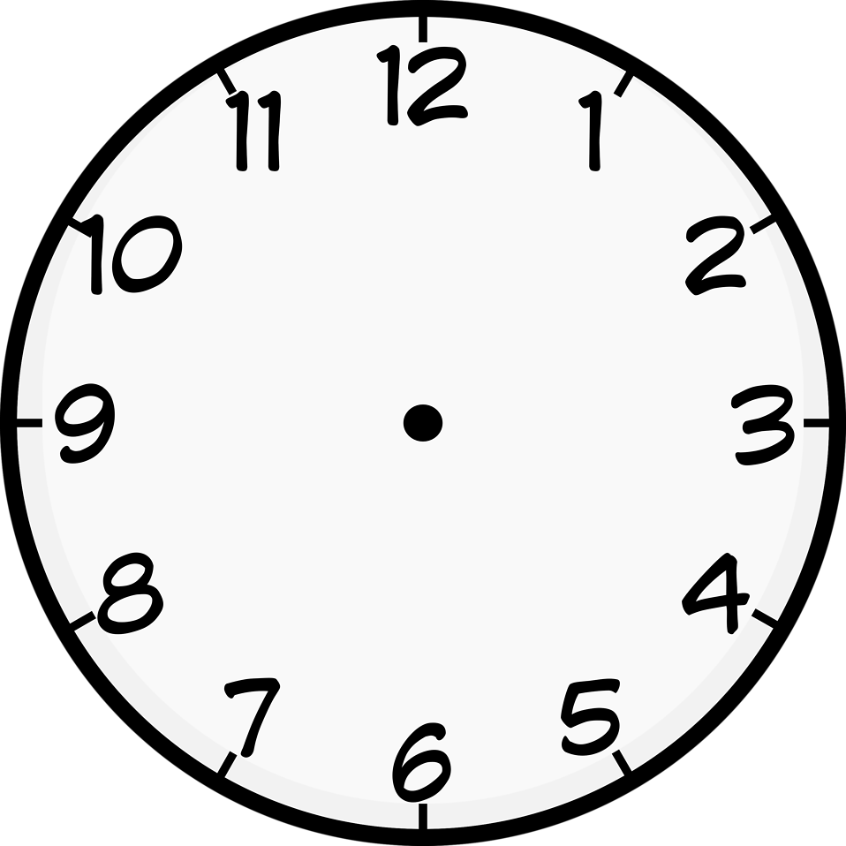
Distance = Rate × Time
Brice rides his bike at a constant speed of 8 mi/h for 15 minutes, then speeds up and rides at a constant speed of 10 mi/h for 30 minutes. During these 45 minutes, how many miles did he travel?
D = R × T
D = 8 mi/h × 15 min
D = 10 mi/h × 30 min
D = 8 mi/h × ¼ h
D = 10 mi/h × ½ h
D = 2 mi
D = 5 mi
D = 2 mi + 5 mi = 7 mi

Slide 4
Distance = Rate × Time
How many minutes faster will Jacob complete a 100-mile drive traveling at a rate of 60 miles per hour than if he traveled at a rate of 50 miles per hour?
D
R
T =
100 mi
50 mi/h
100 mi
60 mi/h
T =
T =
T = 120 min − 100 min
= 20 min
T = 2 h
= 120 min
T = ⁵/3 h
= 1²/3 h
= 100 min

